Slide 1
Stock Market Forecasting Internship Project
Forecasting Apple (AAPL) Stock Prices Using ARIMA, SARIMA & LSTM
Prepared By: Amaya Rajan K
Internship Role: Machine Learning / Data Science Intern
Organisation: ZIDIO Development
Year: 2025

Slide 2
Project Introduction
Objective: Forecast short-term closing prices of Apple Inc. (AAPL).
Developed as part of a Machine Learning internship.
Implements classical statistical models (ARIMA, SARIMA) and a deep-learning model (LSTM).
Built using a structured industry-standard Python workflow.

Slide 3
Techniques Used
ARIMA – Linear model capturing trend using autoregression and differencing.
SARIMA – ARIMA extended with seasonal pattern detection.
LSTM – Deep learning model capable of nonlinear sequential learning.
All models trained using historical AAPL stock closing prices.

Slide 4
Software & Tools Used
Python
Pandas, NumPy – Data processing
Matplotlib, Seaborn – Visual analytics
Statsmodels – ARIMA/SARIMA
TensorFlow/Keras – LSTM neural networks
YFinance – Stock price data extraction

Slide 5
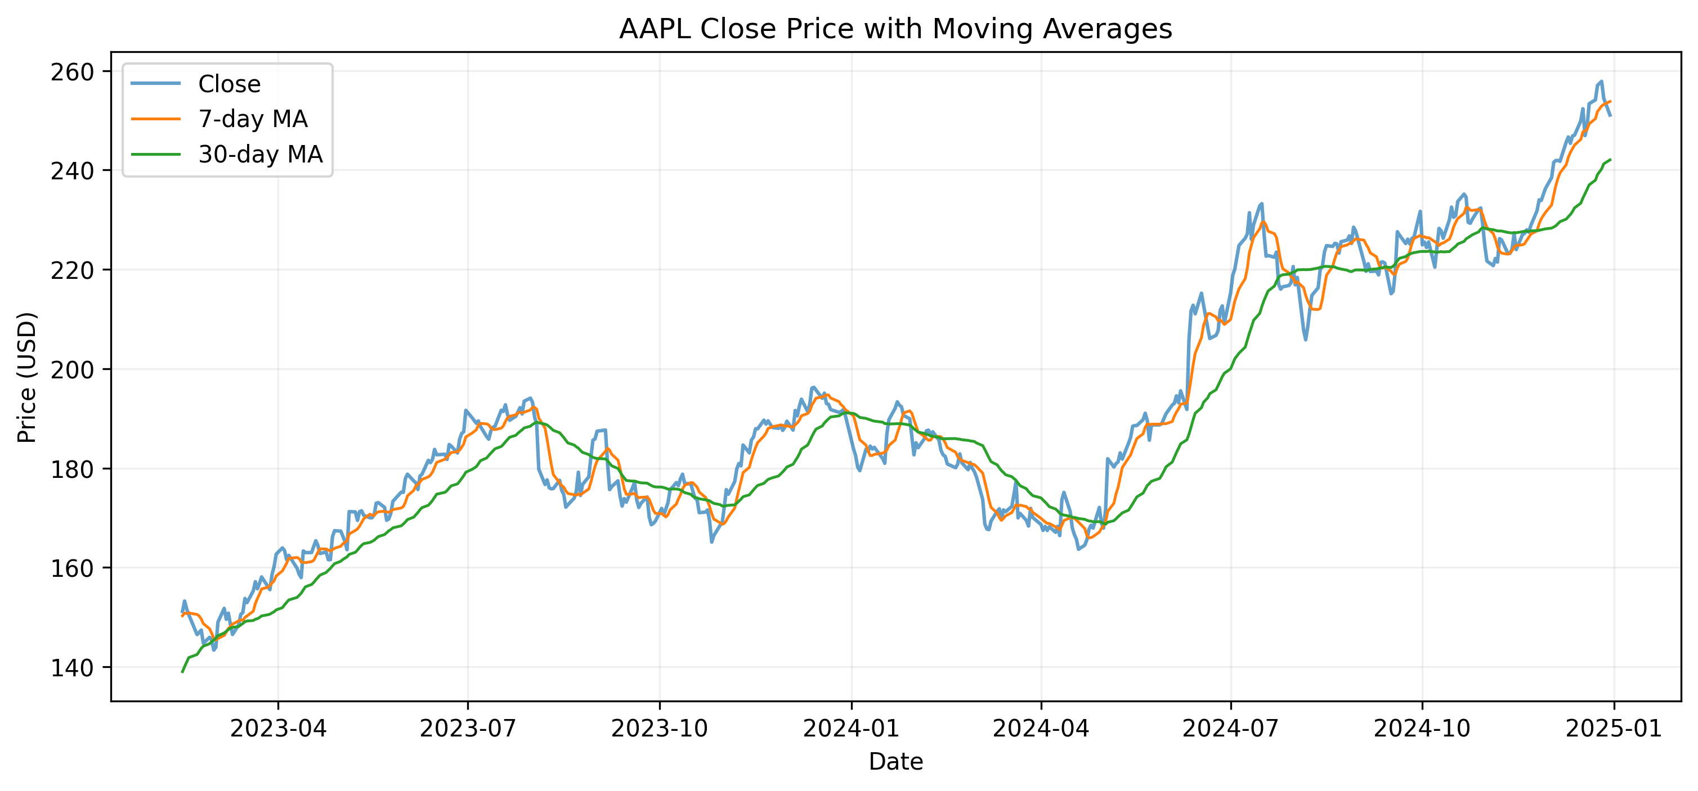
Stock Trend & Moving Averages
Insights:
7-day & 30-day moving averages highlight longer-term trend direction.
Shows the general upward/downward momentum of AAPL stock.
Helps reduce noise and smoothen volatility for interpretation.

Slide 6
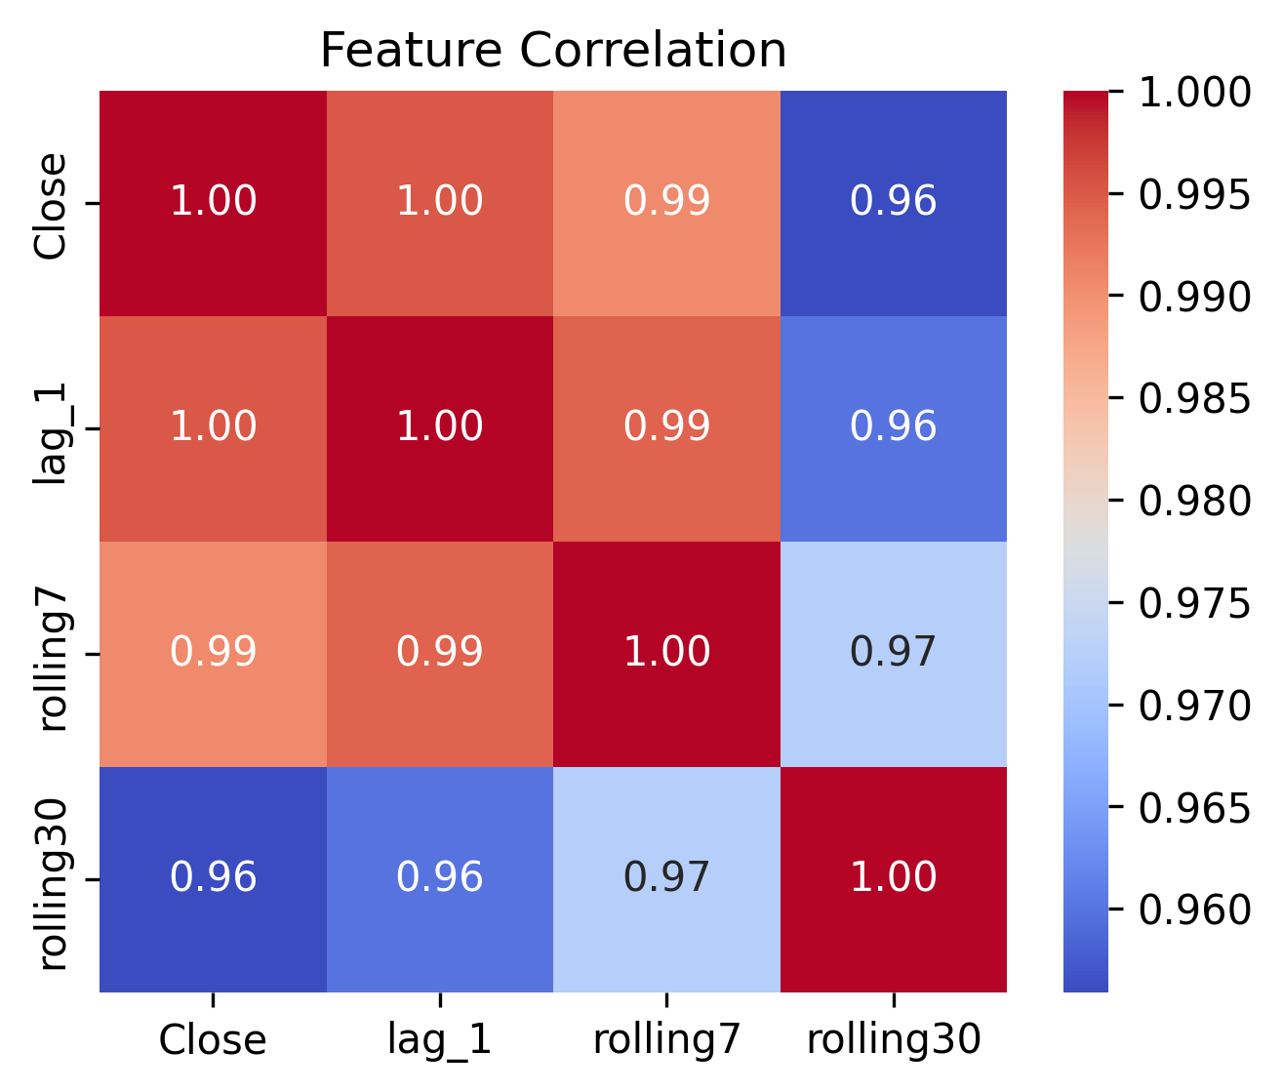
Feature Correlation Analysis
Insights:
Lag-1 feature has the strongest correlation with actual price.
Rolling features help stabilize short-term fluctuations.
Confirms strong time dependency in stock price behaviour.

Slide 7
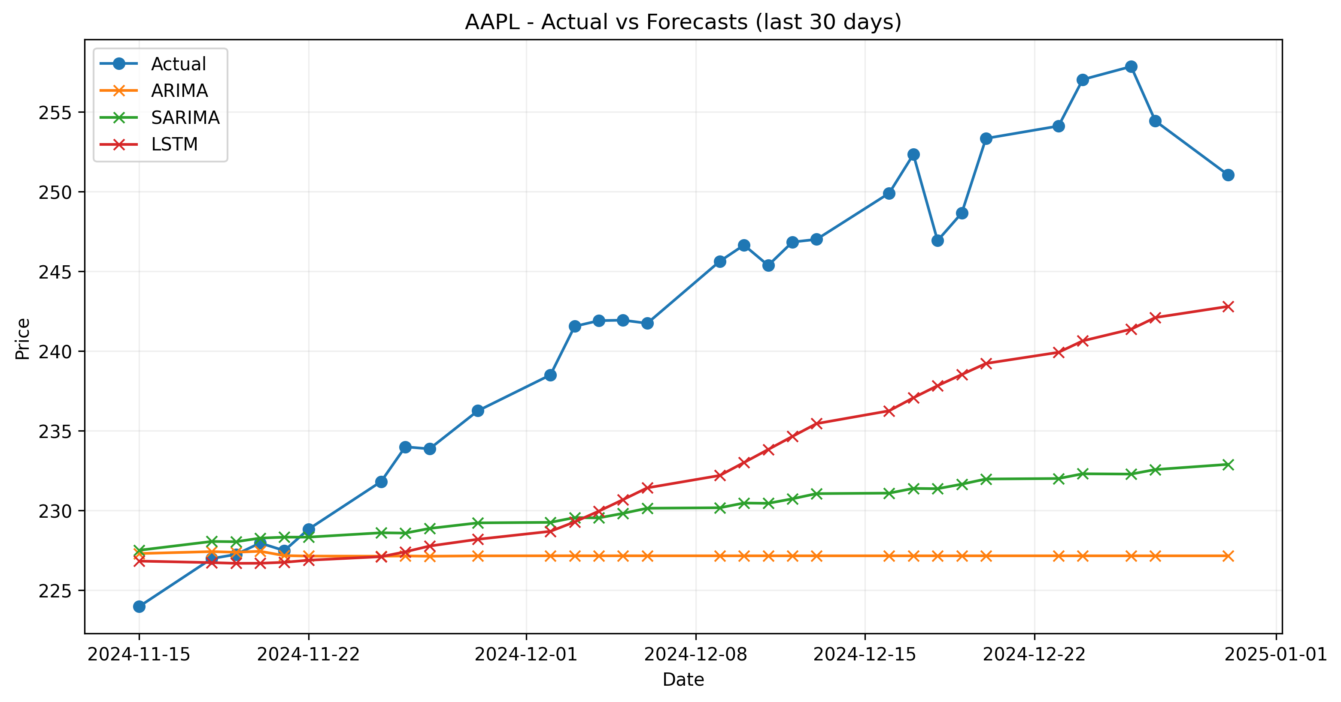
Model Forecast Comparison
Insights:
ARIMA: Produces nearly flat forecasts; underfits market volatility.
SARIMA: Captures mild seasonality; better than ARIMA.
LSTM: Most accurate and realistic; closely follows actual price movement.

Slide 8
Model Output Interpretation
Insights:
ARIMA & SARIMA produce smoother, trend-focused forecasts.
LSTM models complex nonlinear stock behavior.
LSTM's predictions reflect stronger real-world correlation.

Slide 9
Model Performance Summary
From model_comparison.csv:
ARIMA MAPE: 6.09%
SARIMA MAPE: 4.96%
LSTM MAPE: 4.25% (BEST)
Insights:
LSTM delivered the lowest errors across all metrics.
SARIMA improved over ARIMA due to seasonality modeling.
Deep learning approach proved most effective.

Slide 10
Conclusion
Conclusion
Complete stock forecasting pipeline successfully developed.
LSTM outperforms classical models significantly.
Demonstrates strong skills in ML, DL, Time-Series Analysis, and Financial Modelling.
Pipeline can be extended to multiple stocks and additional predictive features.
Suitable for real-world financial forecasting applications.

Slide 11
Thank You

